Slide 1
Animal Aerodynamics
Day 2

Slide 2
Let’s Recap

Slide 3
What is biomimicry?
Biomimicry is a way of copying what works in nature and using it to find solutions to the problems that humans face.

Slide 4
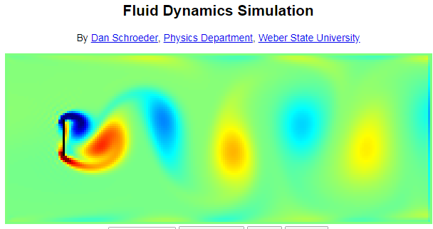
physics.weber.edu/schroeder/fluids/

Slide 5
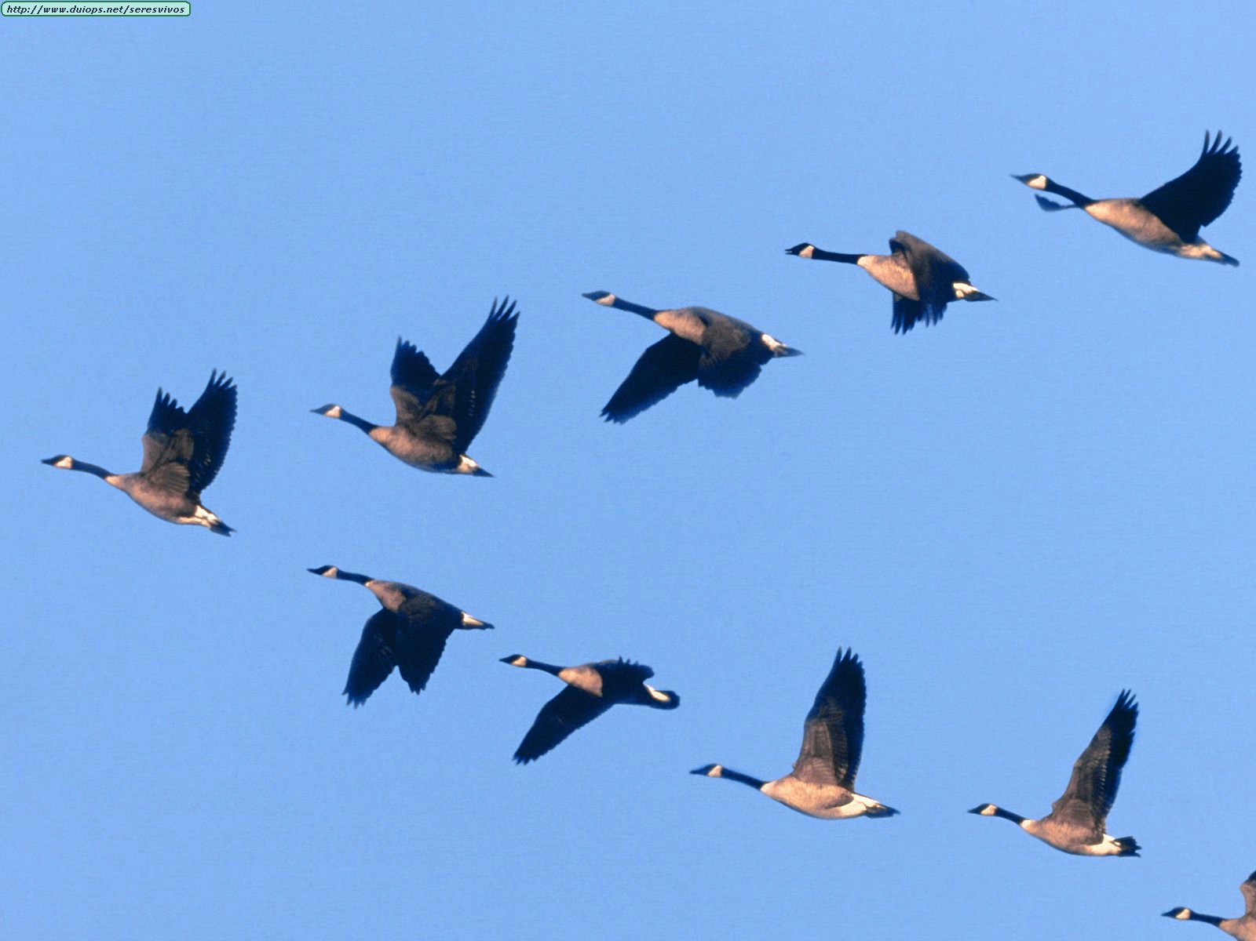
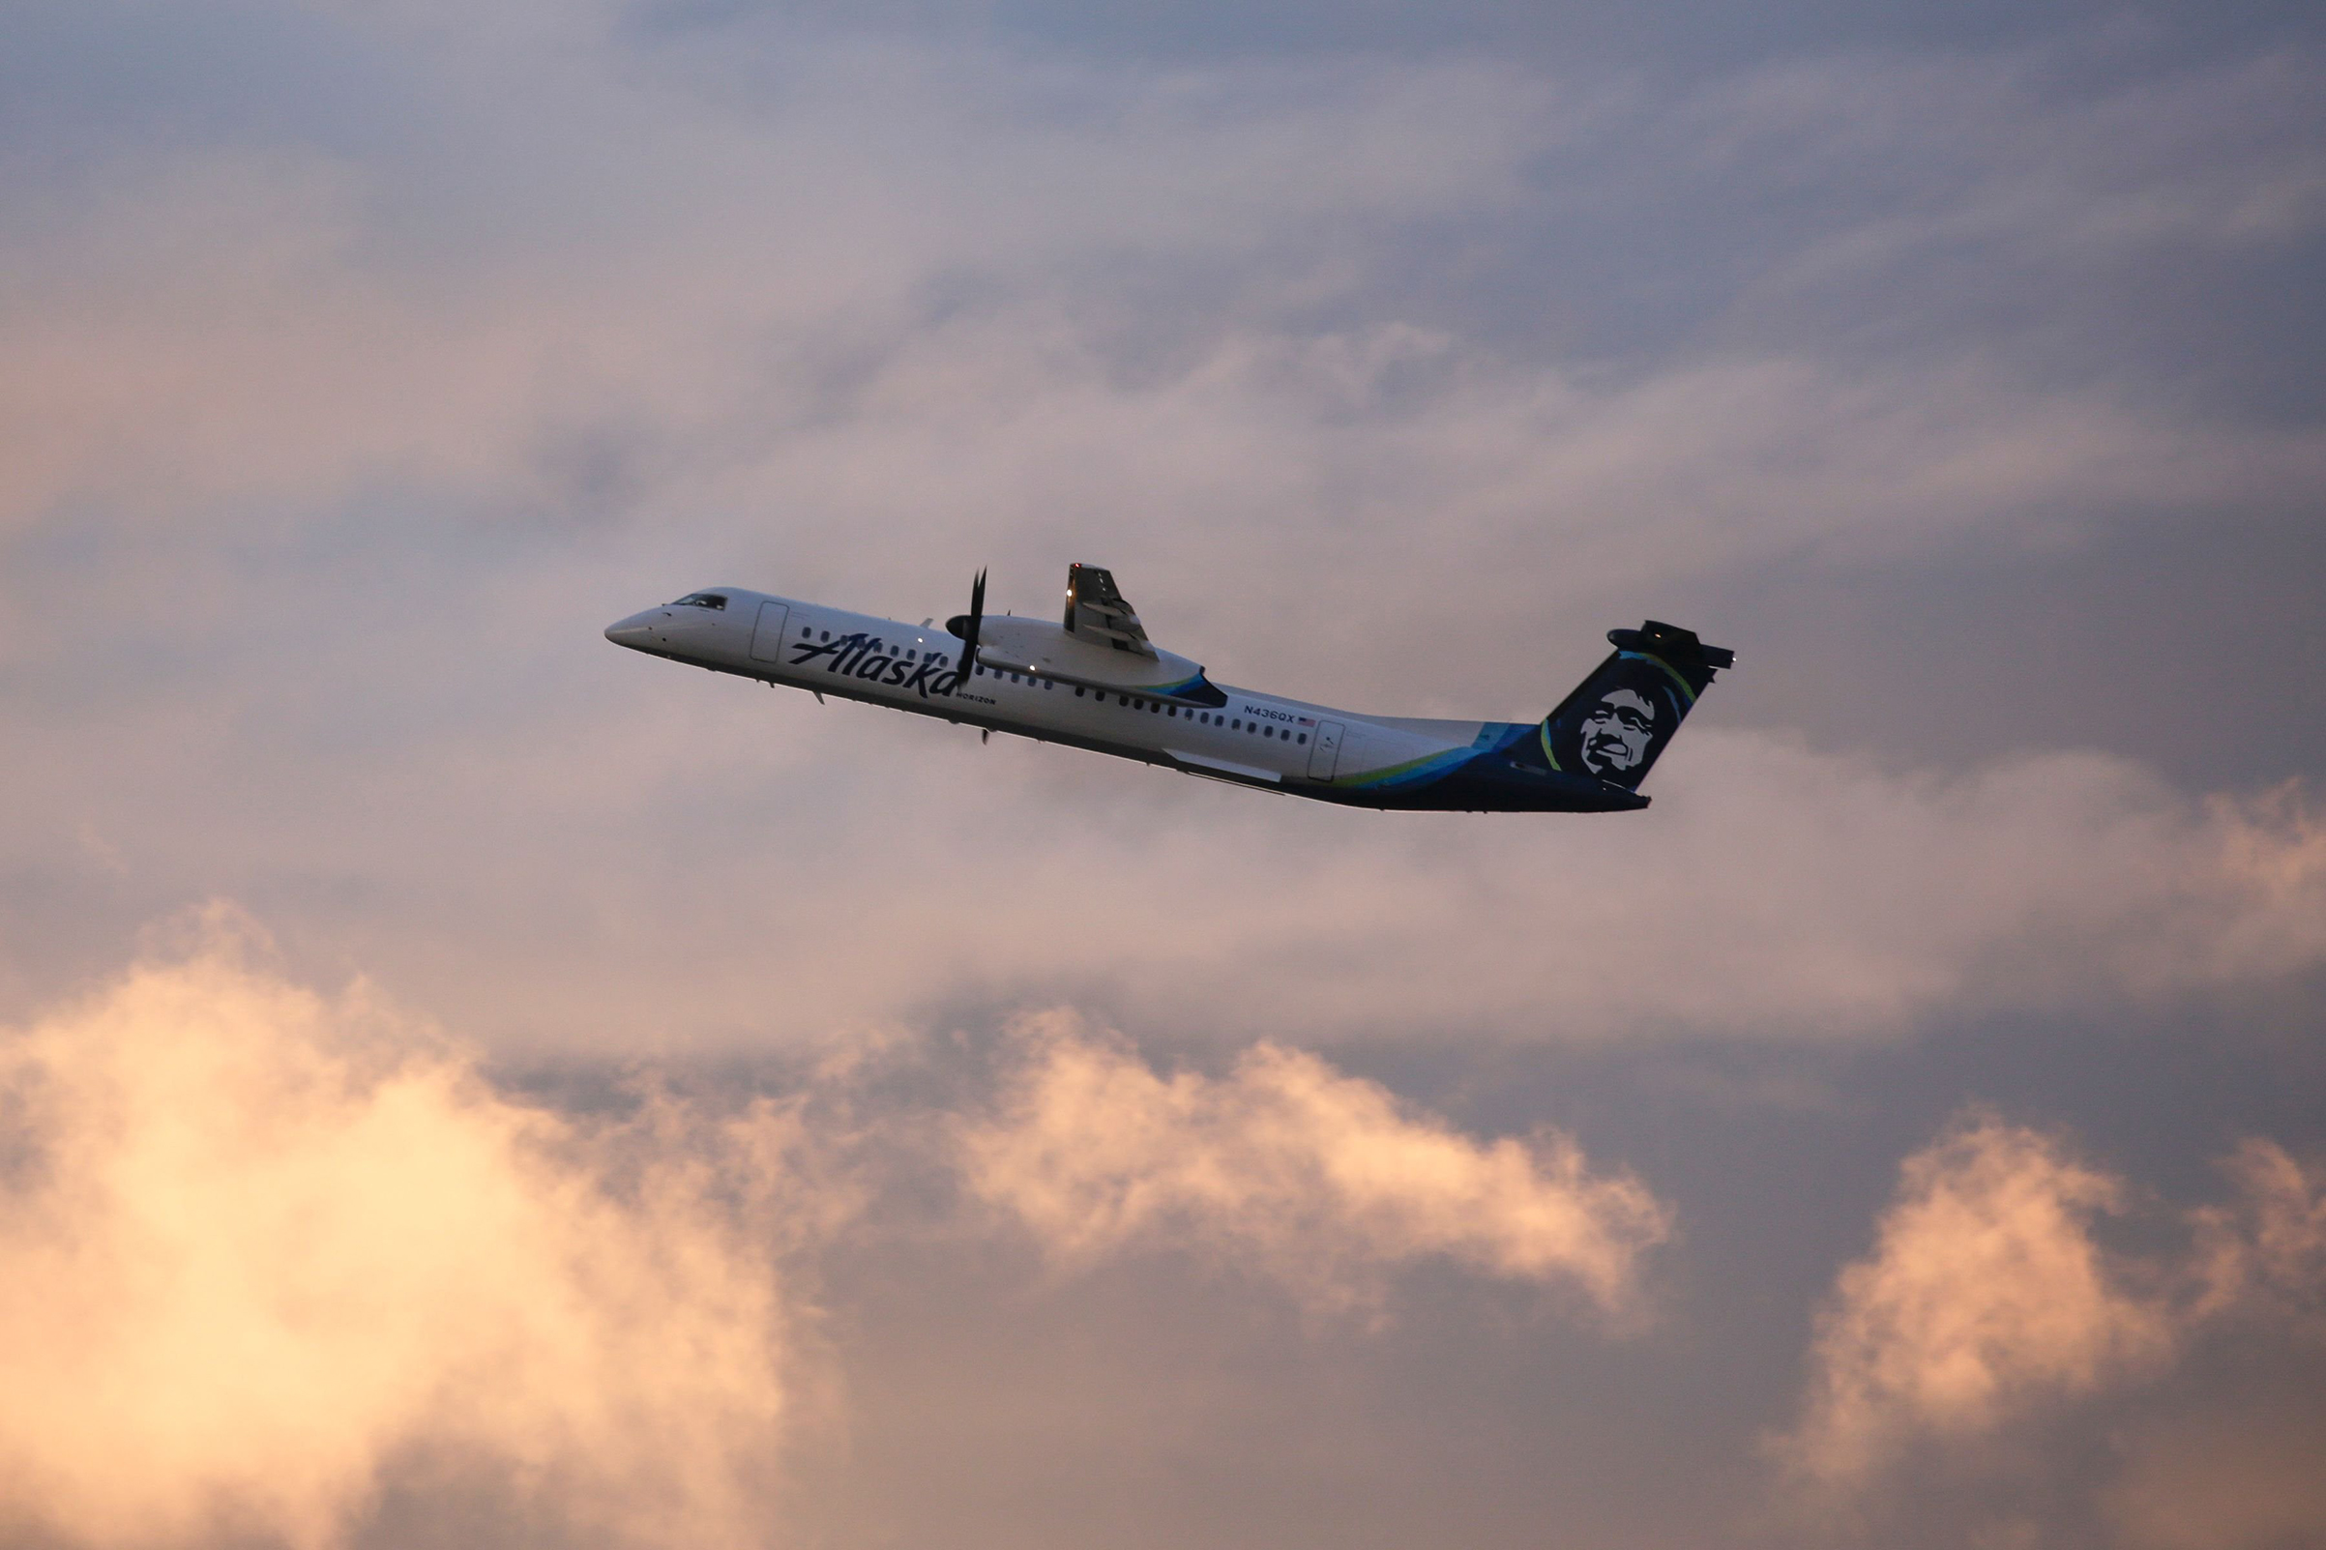
Can inspiration from nature change the way we travel?

Slide 6
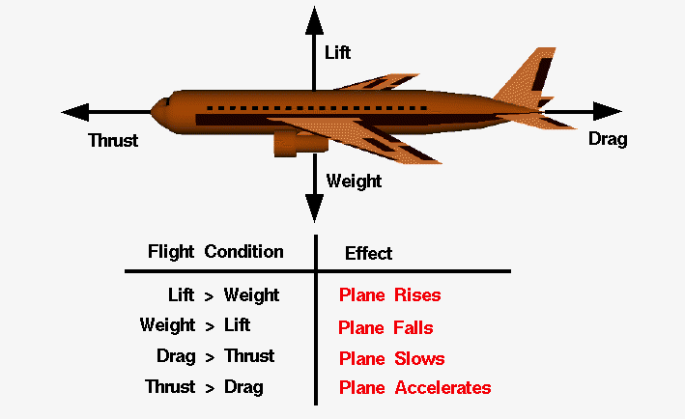
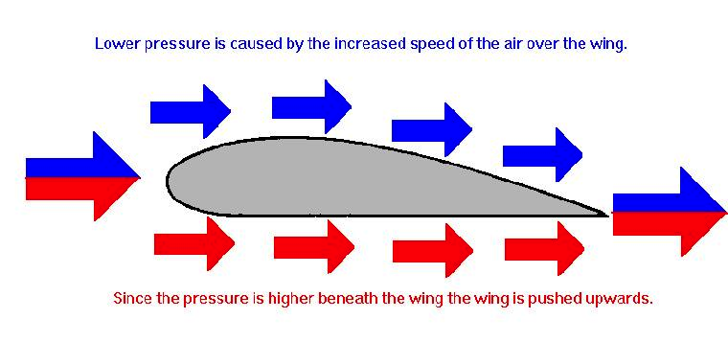
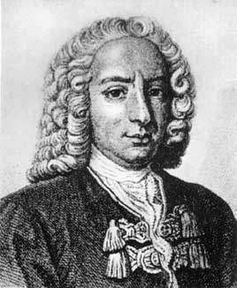
What do we need to know?

Slide 7
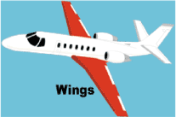
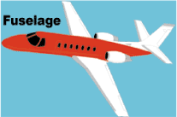
How do we make an
animal-inspired aircraft?
https://www.grc.nasa.gov/www/k-12/UEET/StudentSite/airplanes.html

Slide 8
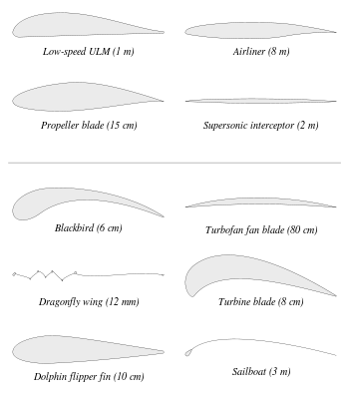

Slide 9
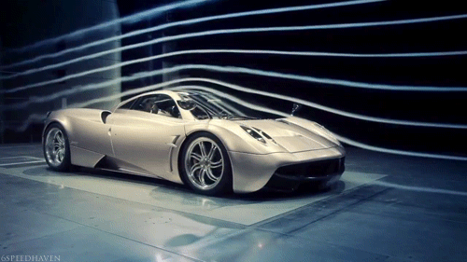
How can we see these?

Slide 10
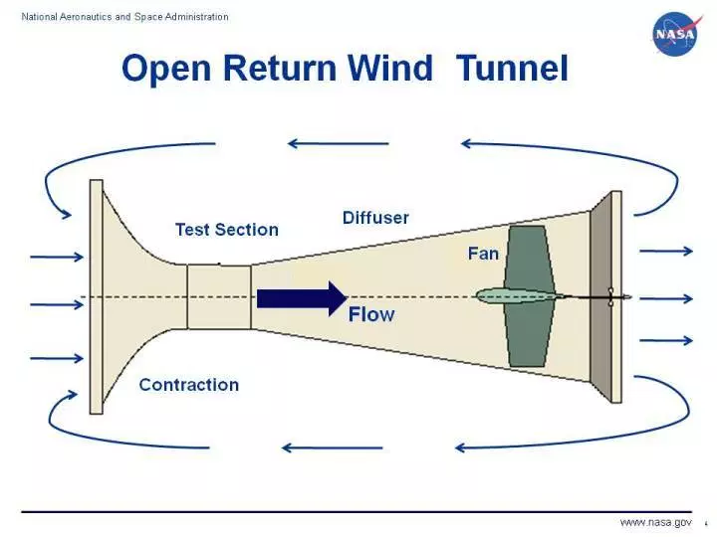
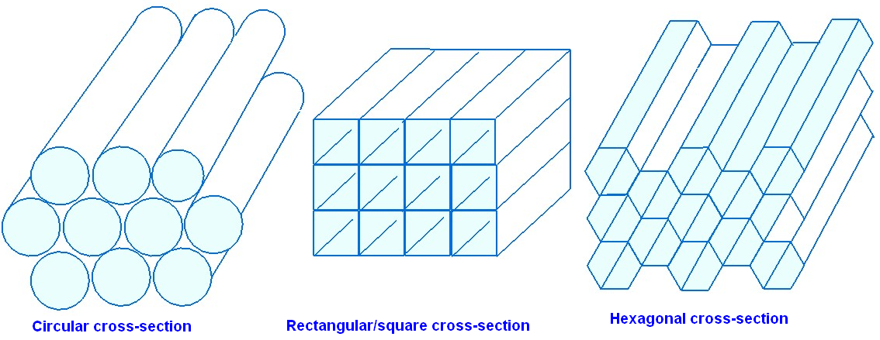
Wind Tunnel
Settling Chamber

Slide 11
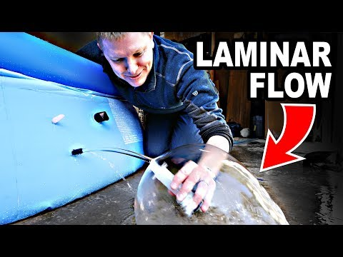
Wind Tunnel
Notes:
Skip to 3:44

Slide 12
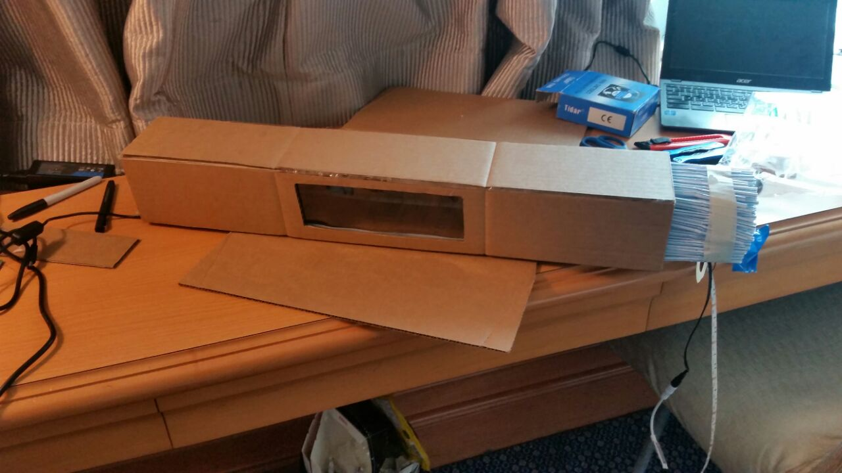
Wind Tunnel

Slide 13
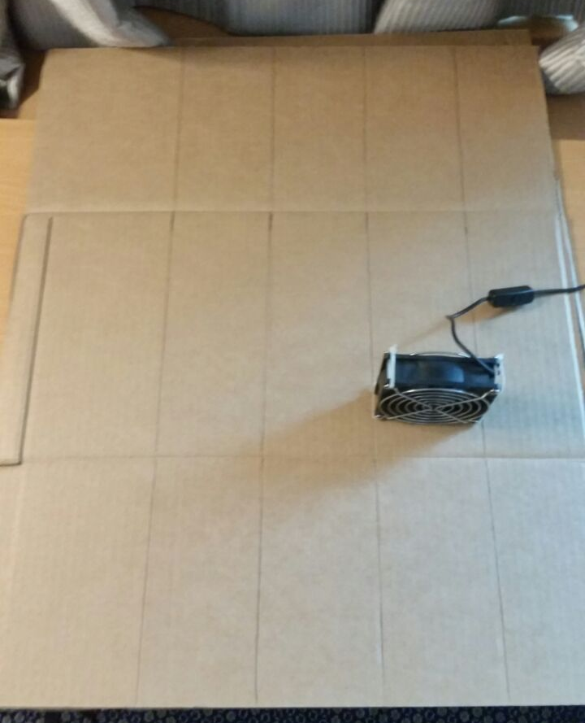

Slide 14
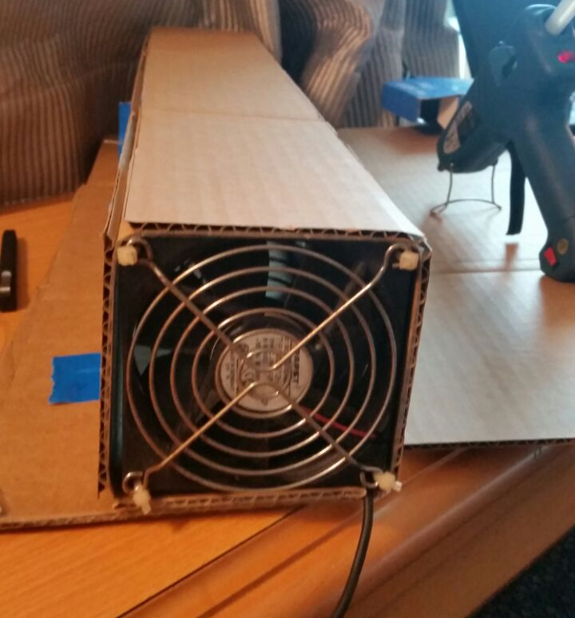

Slide 15
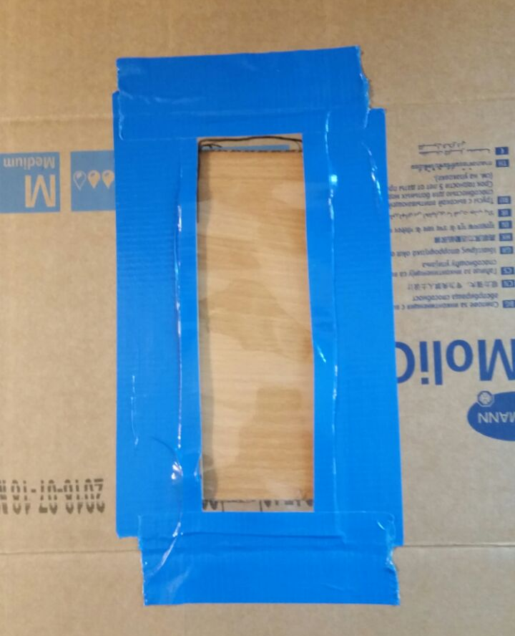

Slide 16
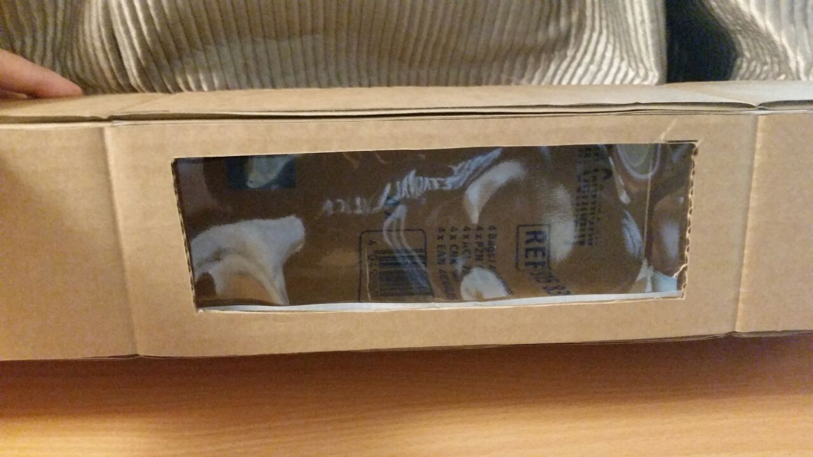

Slide 17
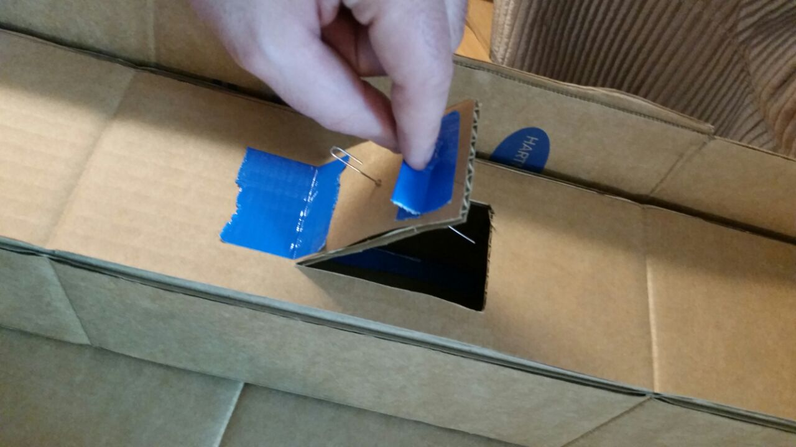

Slide 18
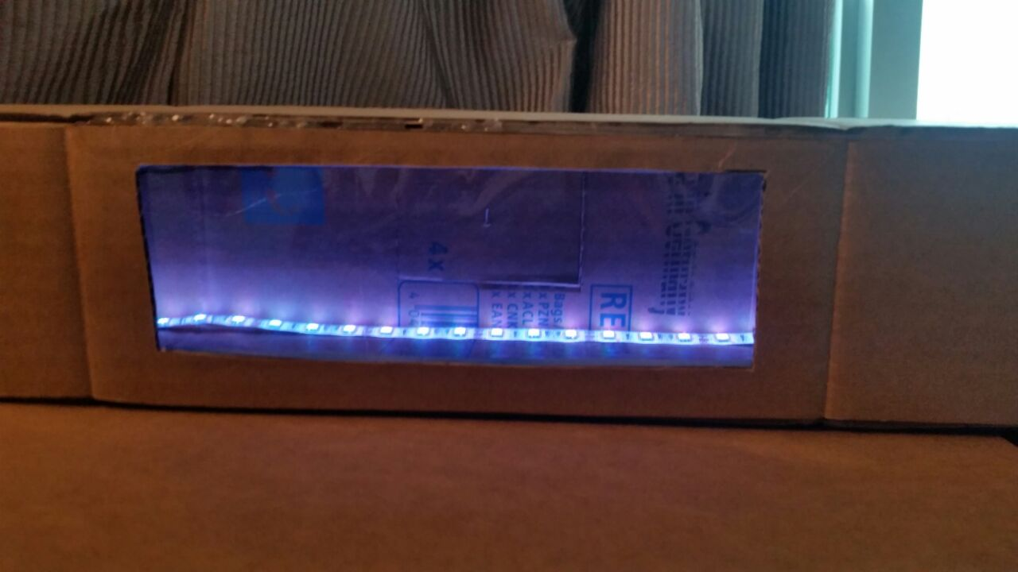

Slide 19
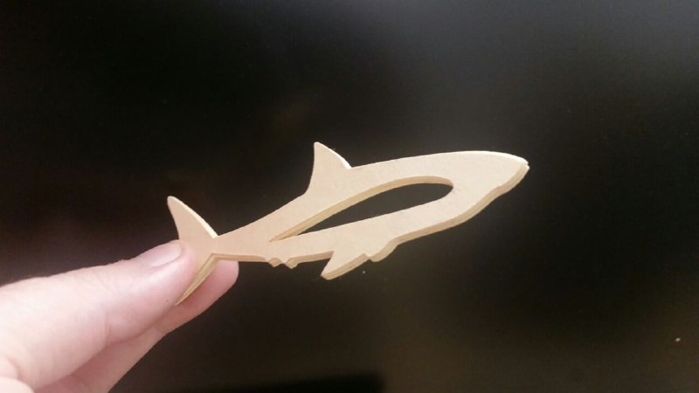

Slide 20
